Slide 1
Towards Understanding The Hidden Popularity of Machine Learning Datasets
Ahmet Akkoc

Slide 2
Icebreaker: What does your citation count mean to you? (Don’t answer!)

Slide 3
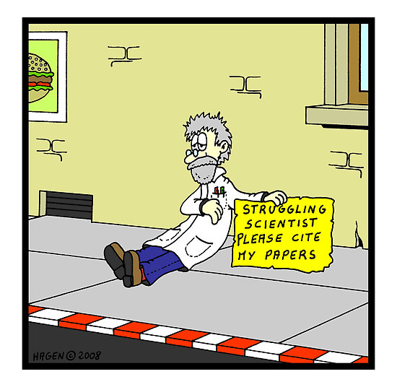
Background: Academic Research
In Academia research is disseminated and shared in the form of lectures, books, conferences and journals.
Citation tracking and analysis is used to rank publications.
Machine learning (ML) is a key part of research
and ML datasets are an essential component of ML.
However, many datasets are often published in less formal and non-academic settings.
Web-first.
This makes it hard to cite/track citations on ML datasets.
Notes:
high-quality data has always been necessary for decent results.
Add Impact factor and ranking citation.

Slide 4
Goal: To find a way to assess the popularity of ML datasets through dataset mentions.

Slide 5
What is a dataset?
A dataset is a file meant for sharing data (tabular, imaging etc.) for statistical analysis or machine learning. In this work I focus on Medical ML, where I first noticed that this is a big issue.
The one extension I make is to include data synthesizers in addition to static datasets.
Data synthesizers are code-snippets or libraries that are able to generate new data at run-time. While they might not be “sets” by the mathematical definition, data synthesizers do build datasets and two datasets generated by the same synthesizer may be considered sufficiently related.
Besides datasets, it should be noted that there are other openly available resources used in research, such as pre-trained machine learning models.
I do not focus on these.

Slide 6
mention: citations and unusual references

Slide 7
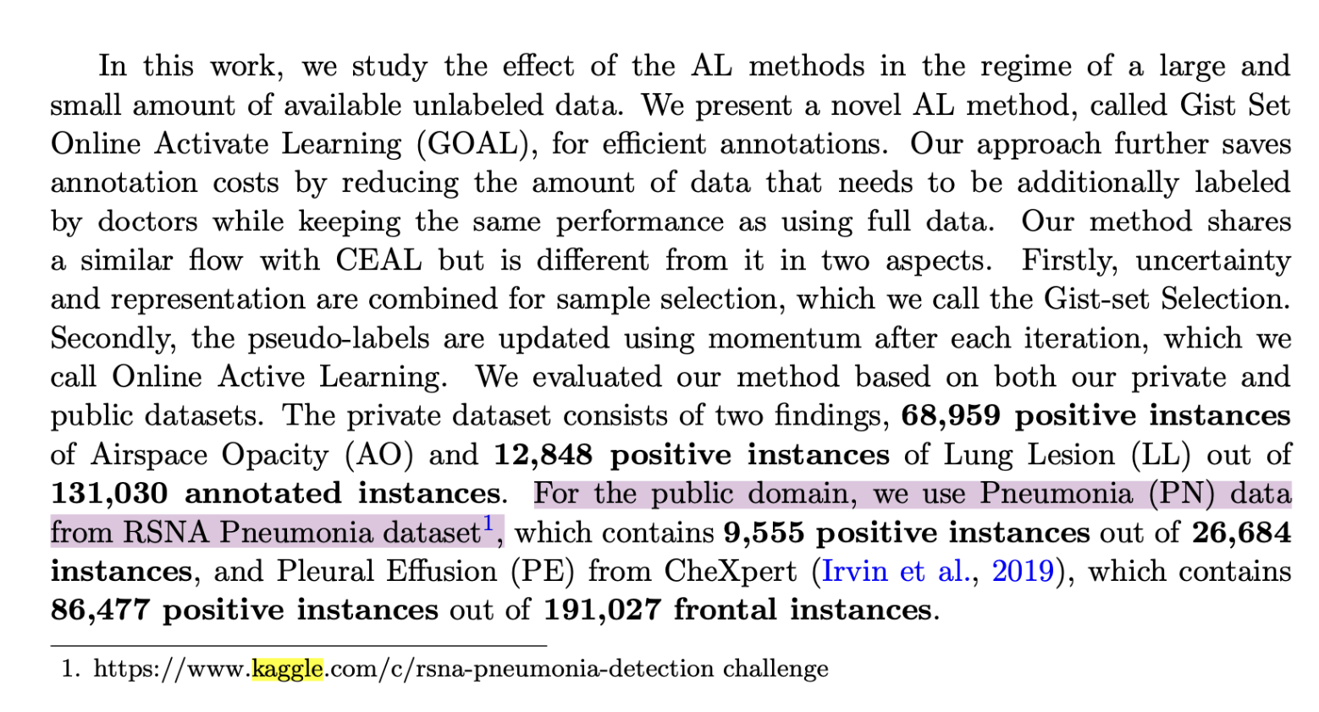
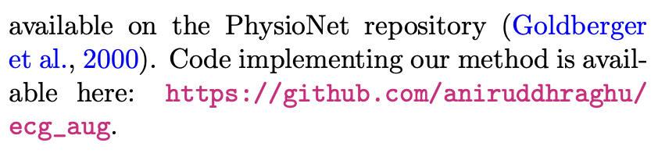
Not all mentions are citations
Some dataset mentions are cited properly. Those mentions which are being published as part of a paper cannot be referred to outside of a URL.
Some mentions are only footnotes.
Nguyen, C., Huynh, M.T., Tran, M.Q., Nguyen, N.H., Jain, M., Ngo, V.D., Vo, T.D., Bui, T. &; Truong, S.Q.H.. (2021). GOAL: Gist-set Online Active Learning for Efficient Chest X-ray Image Annotation. Proceedings of the Fourth Conference on Medical Imaging with Deep Learning, in Proceedings of Machine Learning Research 143:545-553 Available from https://proceedings.mlr.press/v143/nguyen21a.html.
Raghu, A., Shanmugam, D., Pomerantsev, E., Guttag, J. &; Stultz, C.M.. (2022). Data Augmentation for Electrocardiograms. Proceedings of the Conference on Health, Inference, and Learning, in Proceedings of Machine Learning Research 174:282-310 Available from https://proceedings.mlr.press/v174/raghu22a.html.

Slide 8
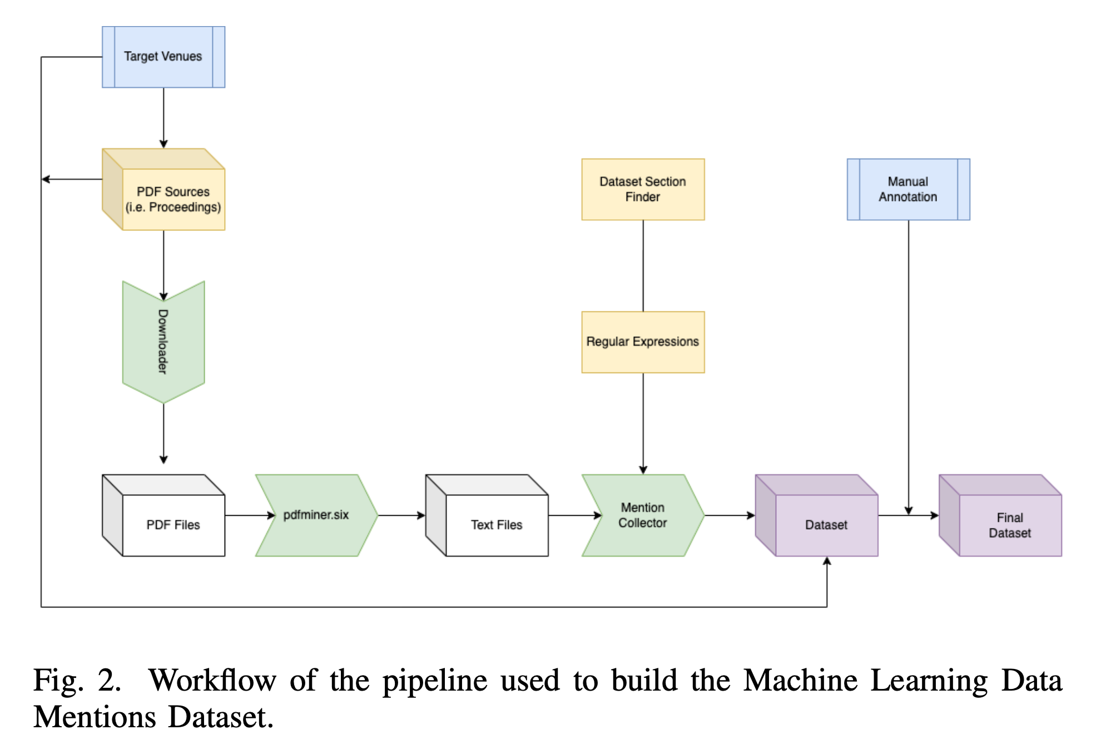
Gathering Dataset Mentions: Project Workflow
1) Determine target venues to search for dataset mentions.
2) Collect PDF Sources from Online Proceedings. Namely, I wrote my code around Proceedings of Machine Learning Research (PMLR)
3) Use a pdf processor to extract raw text from the collected papers.

Slide 9
Gathering Dataset Mentions: Project Workflow
4) In many research papers there is a dedicated section for datasets which were used. This snippet of the text can be used to query dataset mentions quicker.
5) Within the Dataset Section of a paper, I use regular expressions to extract
Type of mention
Citation/Link/Footnote
Notes
Sorting by: Source Venue
Mentioning Paper

Slide 10
Gathering Dataset Mentions: Project Workflow
6) Follow up with manual annotation
Assign dataset identifiers for unique datasets
Merge redundant footnotes and links.
Find footnotes in the body, correct in processed dataset.
Check if dataset is actually accessible through the reference.
Fixing parsing errors.
7) Obtain the final dataset. I named my own dataset…

Slide 11
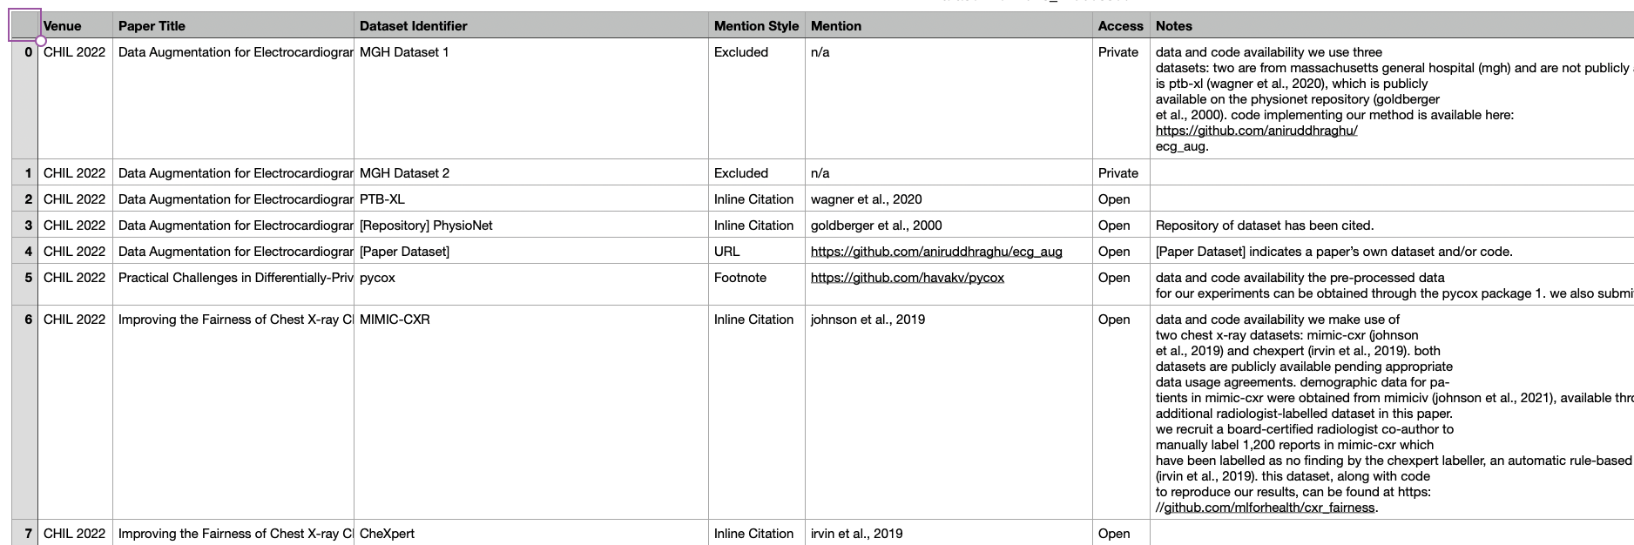

CHIL-MLDM: Machine Learning Dataset Mentions in CHIL 2022

Slide 12
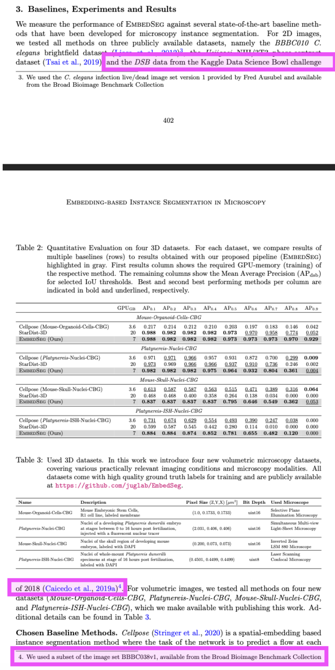
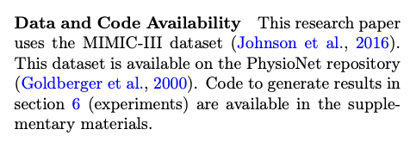
Why CHIL?
Figures can make references difficult for people to read, let alone machines. Example from MIDL ‘21:
Conference on Health, Inference, and Learning (CHIL) reviewers are especially careful with organization. Open Access is encouraged.
Keramati, R., Gottesman, O., Celi, L.A., Doshi-Velez, F. &amp; Brunskill, E.. (2022). Identification of Subgroups With Similar Benefits in Off-Policy Policy Evaluation. Proceedings of the Conference on Health, Inference, and Learning, in Proceedings of Machine Learning Research 174:397-410 Available from https://proceedings.mlr.press/v174/keramati22a.html.
Lalit, M., Tomancak, P. &; Jug, F.. (2021). Embedding-based Instance Segmentation in Microscopy. Proceedings of the Fourth Conference on Medical Imaging with Deep Learning, in Proceedings of Machine Learning Research 143:399-415 Available from https://proceedings.mlr.press/v143/lalit21a.html.
Notes:
I wanted to work on Medical Imaging conferences.

Slide 13
Results
Bibliometric Exclusion in CHIL 2022
Accessibility of Mentioned Work in CHIL 2022

Slide 14
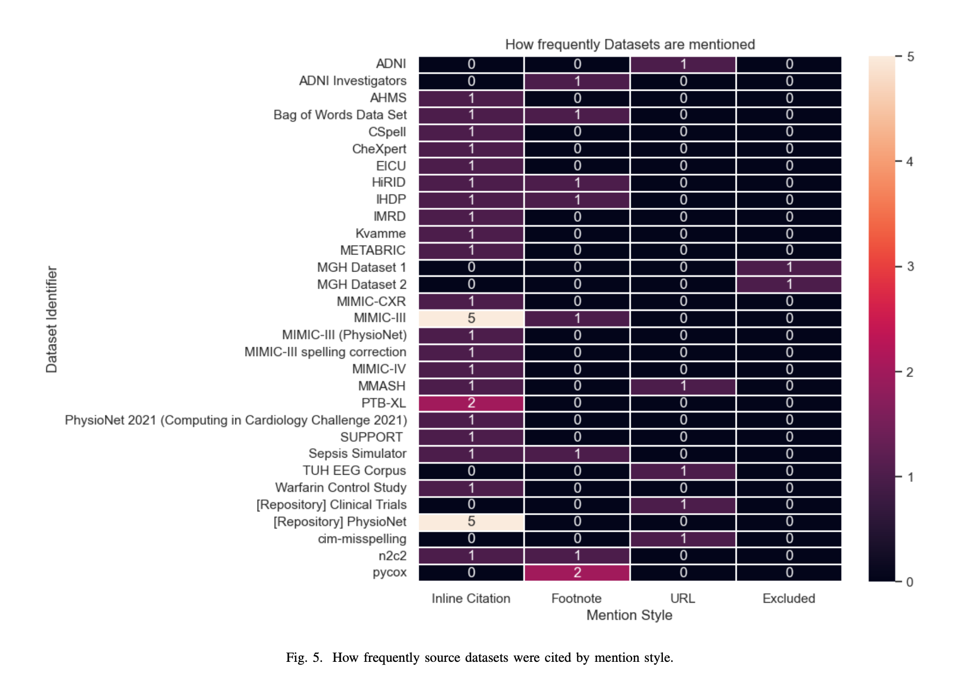
Results: Bibliometric Exclusion
For a used dataset to receive citation tracking, it must be included in the bibliography. But not all are…
In CHIL 2022, I identified N = 31 data sources (datasets and data syntehesizers)
23 (≈ 74%) of the datasets received at least one inline citation.
MIMIC-III dataset and the PhysioNet repository stand out.
Notes:
Note that paper datasets (i.e. self-citations)
PhysioNet is a data repository housing several of the datasets mentioned within CHIL-MLDM. Even so, it was often jointly cited with the MIMIC-III dataset and other related datasets.

Slide 15
Results: Bibliometric Exclusion
The remaining 8 (≈ 26%) of the datasets are never cited in-text. So these are invisible to trackers.
For example pycox, a package containing datasets and data synthesizers for survival analysis, is always mentioned as a footnote.
4 datasets are mentioned as URLs in the body of the text, 2 datasets are only mentioned as a footnote, and 2 private datasets are completely excluded, only being alluded to and never named.
Notes:
Pycox has over 500 stars on GitHub

Slide 16
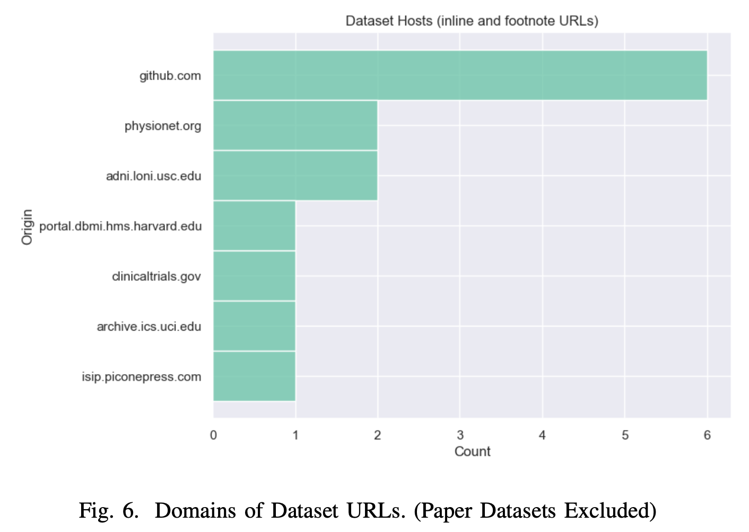
Results: Dataset Accessibility (Availability)
Link/Footnote mentions are also interesting to look at.
Datasets reside in different corners of the web.
For the datasets in CHIL-MLDM, they are most often hosted on GitHub or the aforementioned PhysioNet.
With PhysioNet also receiving explicit inline mentions.

Slide 17
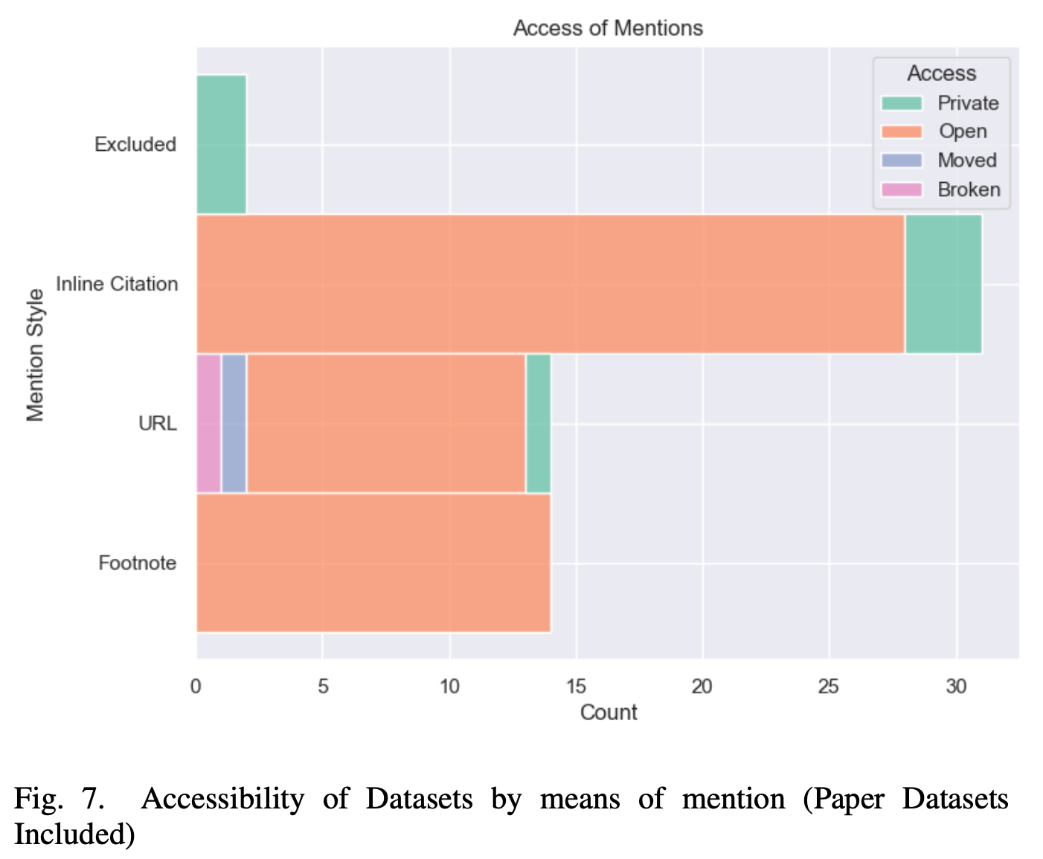
Results: Dataset Accessibility (Availability)
The majority of all mentions (53/66 ≈ 80%) point to open resources.
These are either open-access bibliography, publications open for reading, or URLs pointing to open-source code.
In CHIL 2022, all publications associated with a dataset mention were open-access, therefore an inline citation annotated as “private” means that the associated dataset was private.
It should be restated that CHIL is an open-access conference as-is.

Slide 18
Results: Dataset Accessibility (Availability)
Among the paper datasets themselves:
1 has been moved
1 has had its link broken (i.e. it is no longer available at the given address)
2 datasets were created privately for the sole purpose of a study in cooperation with the Massachusetts General Hospital
3 private datasets were used in previous studies and the reader is referred to the authors of those studies (through citation) if they so wish to obtain said data.
Finally, 1 private dataset has an online request form which the reader is referred to, namely Temple University’s EEG Corpora resource
Notes:
Some institutional or corporate-controlled databases are private, typically made available upon request.

Slide 19
Learnings from data
Datasets and open-resources in medical imaging are very diverse.
In addition to static images, data synthesizers and pre-trained models are also important. Maybe datasource is a better term.
1 in 4 datasources do face bibliographic underrepresentation, in CHIL ‘22.
Meanwhile, the PhysioNet repository as a host to notable datasets such as MIMIC-III, is over-represented thanks to a referable publication.
1 in 5 dataset mentions are not publicly available, in CHIL ‘22. Many are institutional.
But some data are offered upon request, which is good for reproducibility.

Slide 20

Learnings for us
Citation Styles need to become more web-inclusive
Engineering-oriented conferences use IEEE/Chicago Styles
AMA in more medical-tradition journals
However, APA 7th Edition already supports more ways to cite websites and social media.
As authors, it is good to make our work as open (as possible)
And we should strive to list our dependencies in an organized manner. Both for human and machine readability.
This work alone made me realise how difficult it is, even for a human, to label dataset mentions properly.

Slide 21
Q&A

Slide 22
Thank You!

